Slide 1











UNDERSTANDING THE CURRENT MOVIE INDUSTRY
Key areas to focus for maximum success/profitability in the movie industry

Slide 2
INTRODUCTION
Objective: Identify the key areas to focus for maximum success/profitability in the movie industry
Preliminary SQL schema
Dataset
Box Office Mojo
IMDB
TMDB
The Number
Rotten Tomatoes
Actionable insights

Slide 3
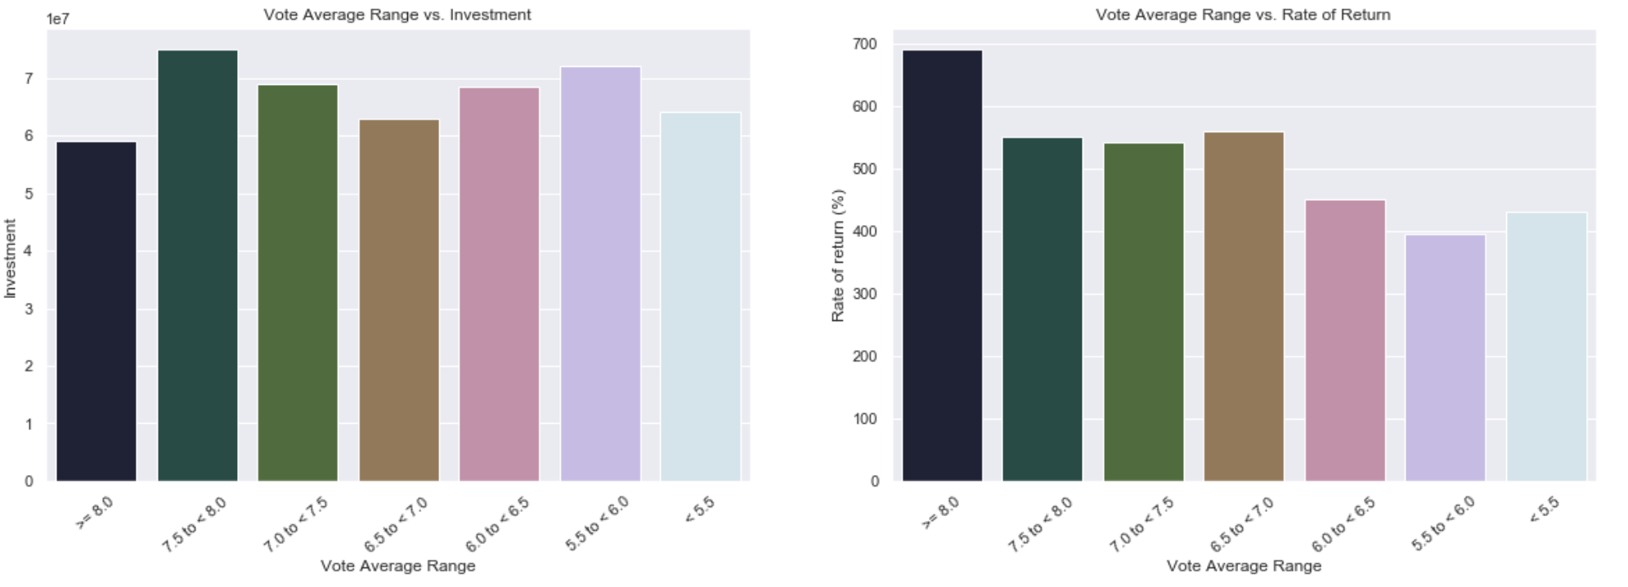
1. Deciding on a movie budget
No clear relationship between the investment/movie budget and the movie reviews
Clear relationship between movie vote/reviews and the rate of return
Highest investment/movie budget doesn’t guarantee the highest rate or return
“Data” suggest that the largest rate of return comes from the lowest budget movies

Slide 4
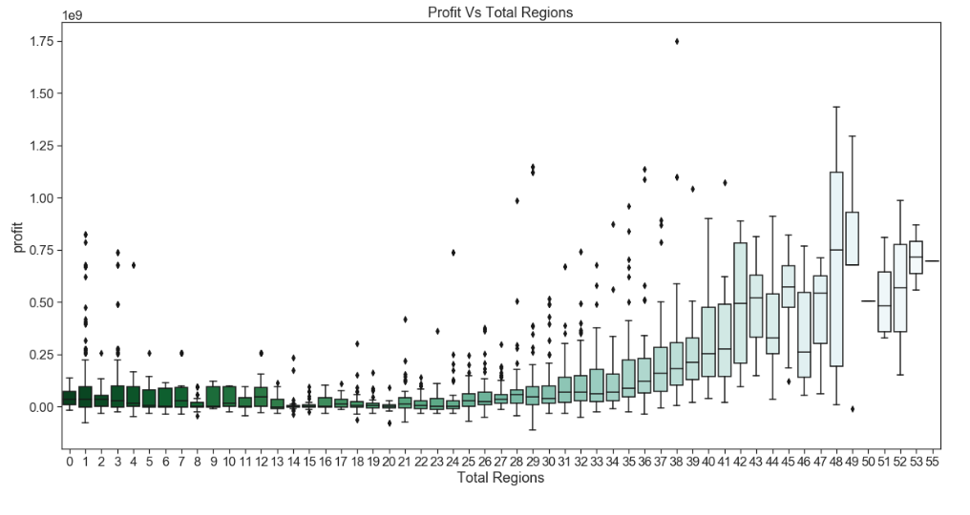
2. Number of locations to release the movie(s)
Movies released in more regions show a wider range of profitability
A worldwide release is made easier with a streaming service

Slide 5
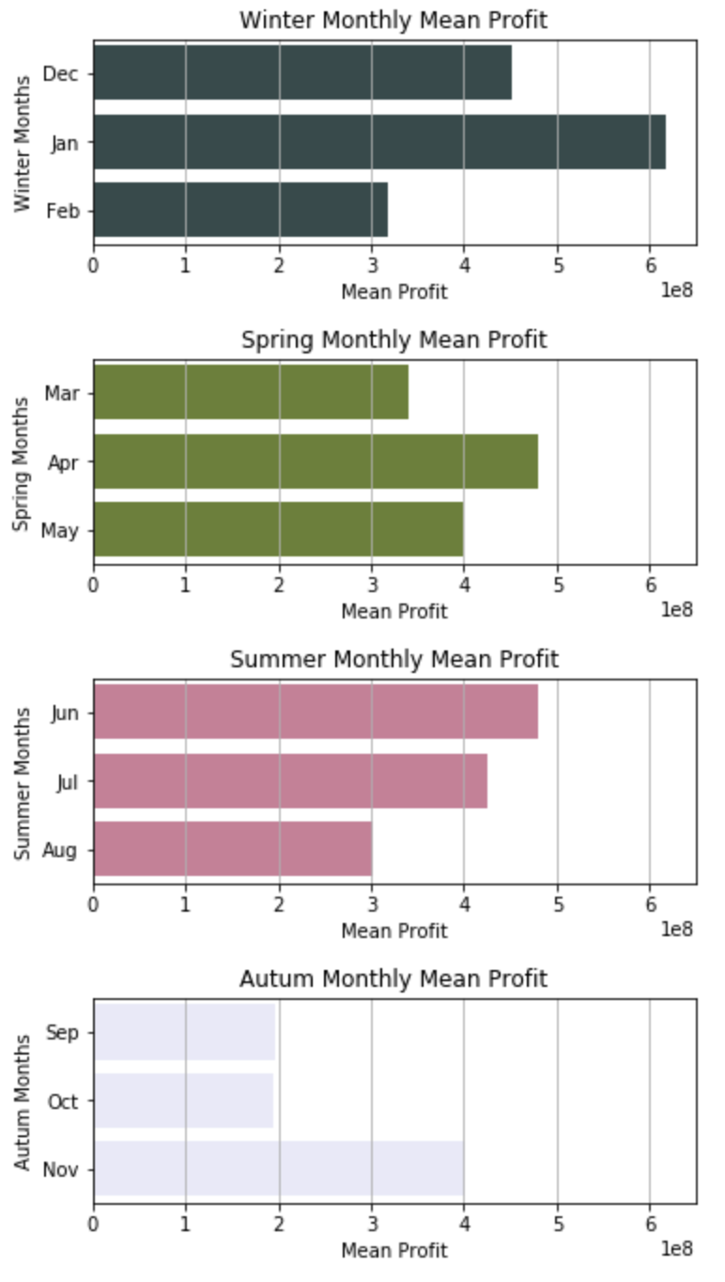
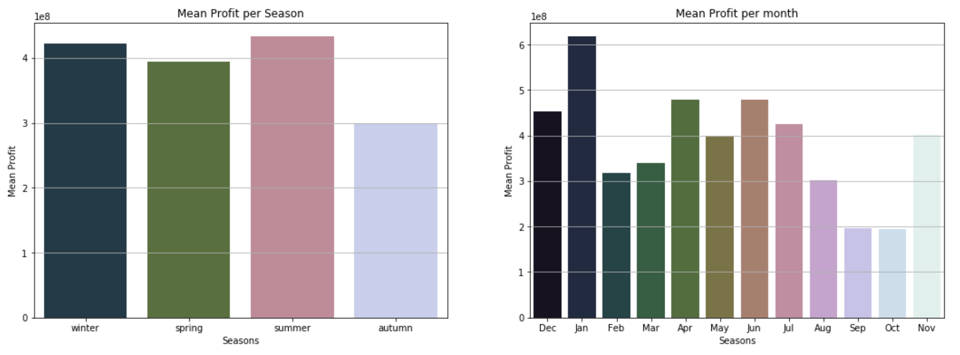
3. Best time of the year to release movie(s)
Total Revenue per Season & Month
Summer and the Winter are the most profitable
Autumn should be avoided
The month with the highest profit is Jan followed by June

Slide 6
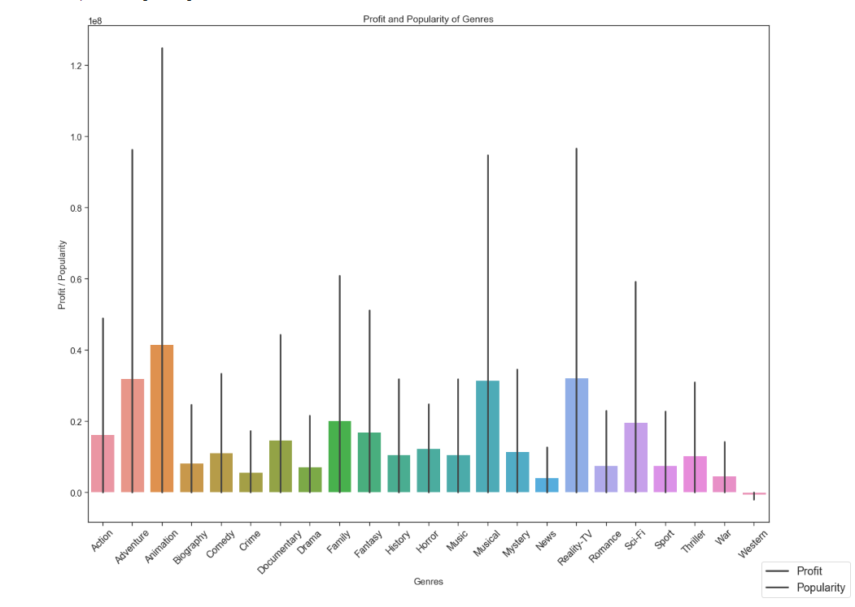
4. Deciding on which genre(s) to focus on

Slide 7
SUMMARY & RECOMMENDATIONS
The highest investment/movie budget will not guarantee the highest rate of return. Follow the audience reviews and make decisions accordingly
Movies released more than regions have high chance of being big hits but also very big flops
Release your block buster movies during the summer and winter focusing on the months of January and June respectively
Animation, Adventure, Musical and Reality TV are more popular and profitable

Slide 8
THANK YOU
Javier Herbas
Neel Patel

